Slide 1
CSE110
Programming Language I

Slide 2
My Brief Profile
Nahian Salsabil (NNS)
Lecturer, CSE, BRACU
BSc: CSE, BUET, 2023
Email: Email: nahian.salsabil@bracu.ac.bd
Room No. UB80601
Consultation Hour:
Sunday: 11:00am - 1:30pm
Monday: 9:30am - 10:50am, 12:30pm - 1:30pm
Wednesday: 9:30am - 10:50am

Slide 3
Links
Resources: http://tiny.cc/cse110_resources_NNS
Slack: http://tiny.cc/cse110_slack

Slide 4
Outline
String

Slide 5
Strings
String is a sequence of ordered characters represented with quotation marks (single('), double(''), triple(' ' ' or '' '' '')) at the beginning and end.
A character can be lower case (a-z) or upper case (A-Z) alphabet, digits (0-9) or special symbols (+, -, #, %, * etc.).
The character order is always from left to right.

Slide 6
Strings: Example
'CSE 110' (using single quotes)
''CSE 110'' (using double quotes)
' ' 'CSE 110' ' ' (using triple single quotes)
'' '' ''CSE 110'' '' '' (using triple double quote)
All of these four String data are exactly same to Python.
The quotes at the beginning and in the end are not part of the String.
CSE 110

Slide 7
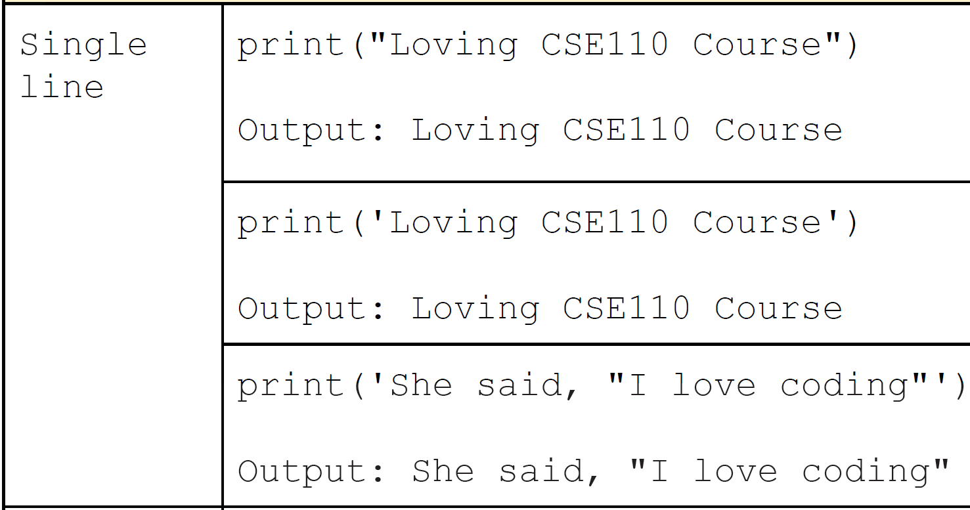
Single Line Strings

Slide 8
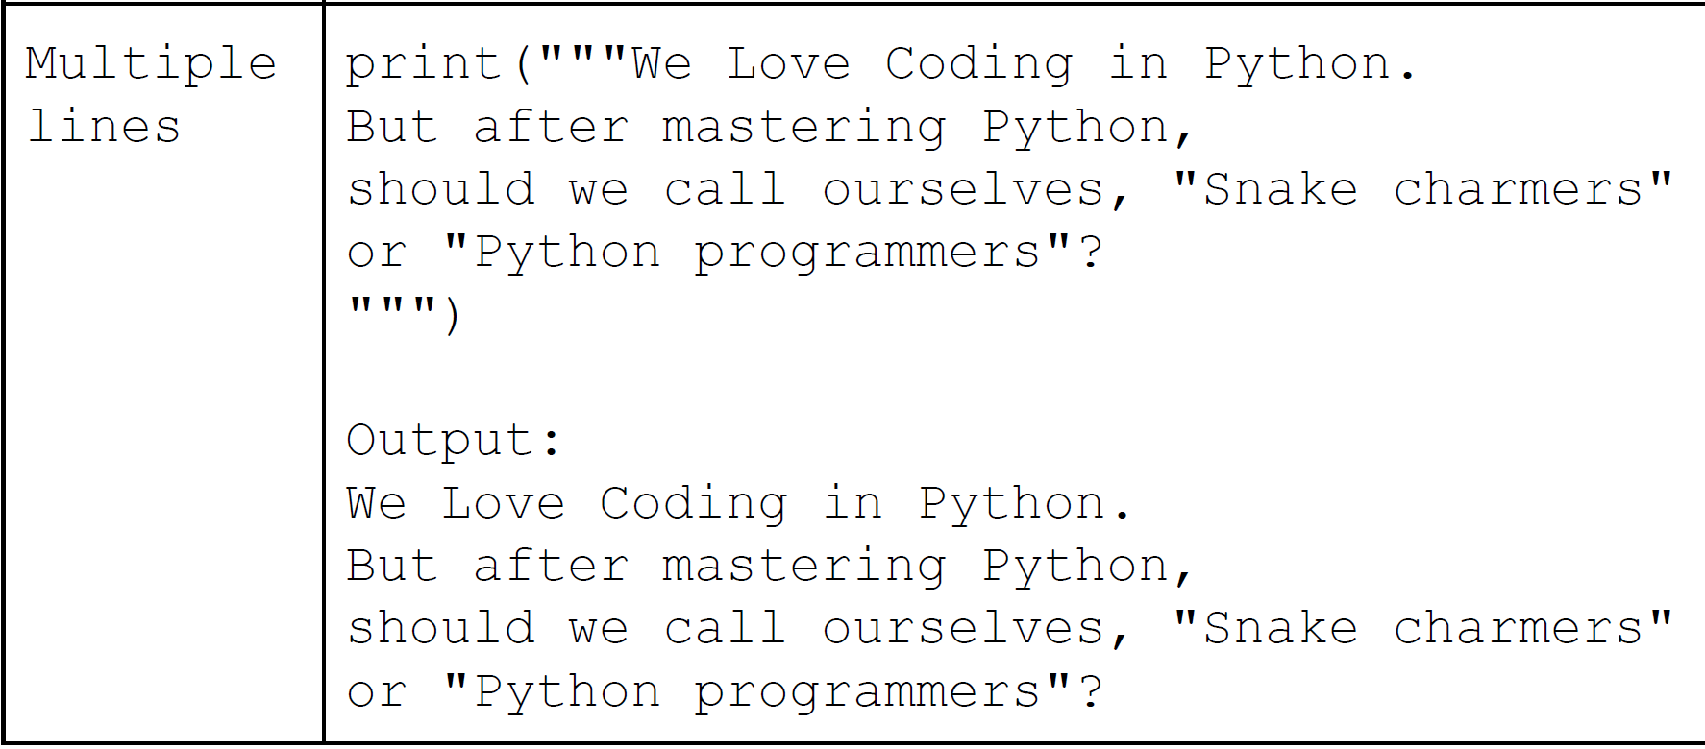
Multi-line Strings

Slide 9
Including quotes in Strings
Python understands the contents of a String using the quotes (single, double or triple) at the beginning and in the end.
Remember that these quotes are not part of the String.
So what if we want to include these quotes as part of the String?
Solution:
Use alternative quotes:
Enclose the strings in double quotes if you have to include single quote
Use escape character or backslash (\)
Precede the quotes with a backslash (\) to tell Python to treat the quotes as part of the String.

Slide 10
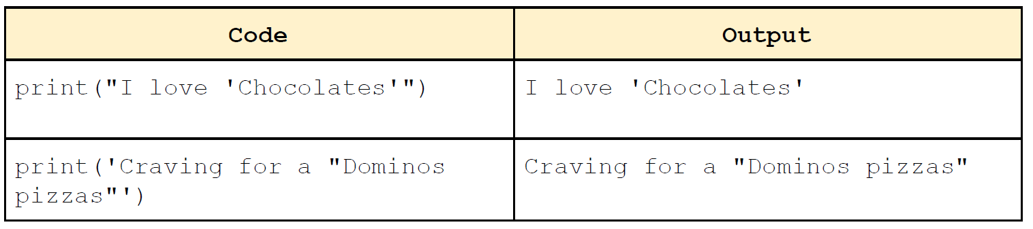
Using Alternative Quotes

Slide 11
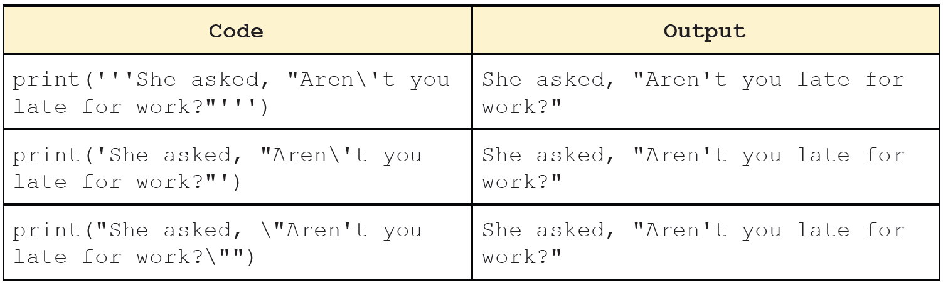
Using escape characters or backslash (\)

Slide 12
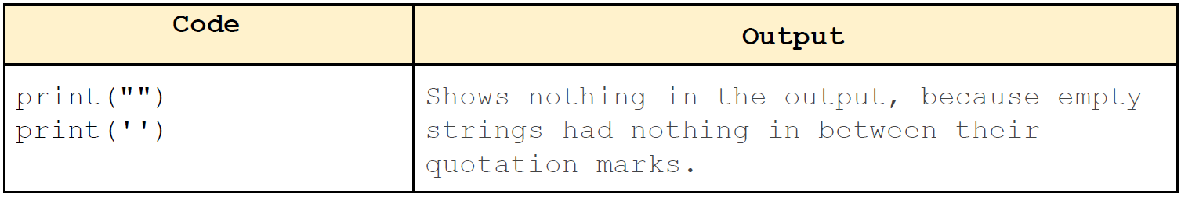
Empty String
Strings represented with only two single( '' ) or two double( "" ) quotes with no characters in between are called Empty String.

Slide 13
Accessing the Characters in a String
What if we want to access the individual characters of a String?
Previously, we saw that it can be accomplished using a for loop.
But using a for loop requires us to traverse the entire String.
But what if we want to access only the specific portions of the String?
Output:
C
S
E
1
1
0
for c in ‘CSE110’:
print(c)

Slide 14
String Indexing
Index indicates the position of a character in a String.
Indexing can be done in two ways:
Positive indexing:
Access the characters from the left side of a string.
Positive indexing always starts from 0 ( left-most character of the string ) and ends at the last character of the string.
Negative indexing:
Access the characters from the right side of a string.
Negative indexing always starts from -1 ( rightmost character of the string ) and ends at the first character of the string.
Indices are always integers.

Slide 15
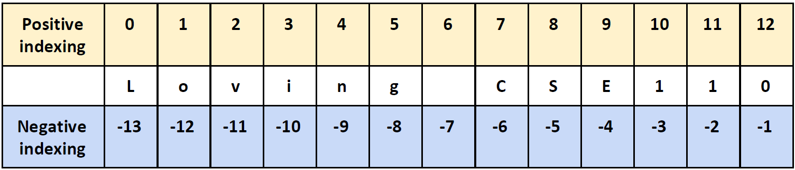
String Indexing
0
12
Loving CSE110
-13
-1

Slide 16
String Indexing
To access the character at a specific index or position, we need to do the following:
If anything out of the valid range is tried to be accessed, the program will yield an IndexError.
If any other data type except an integer is entered as an index, TypeError will rise.
name_of_string[ index ]

Slide 17
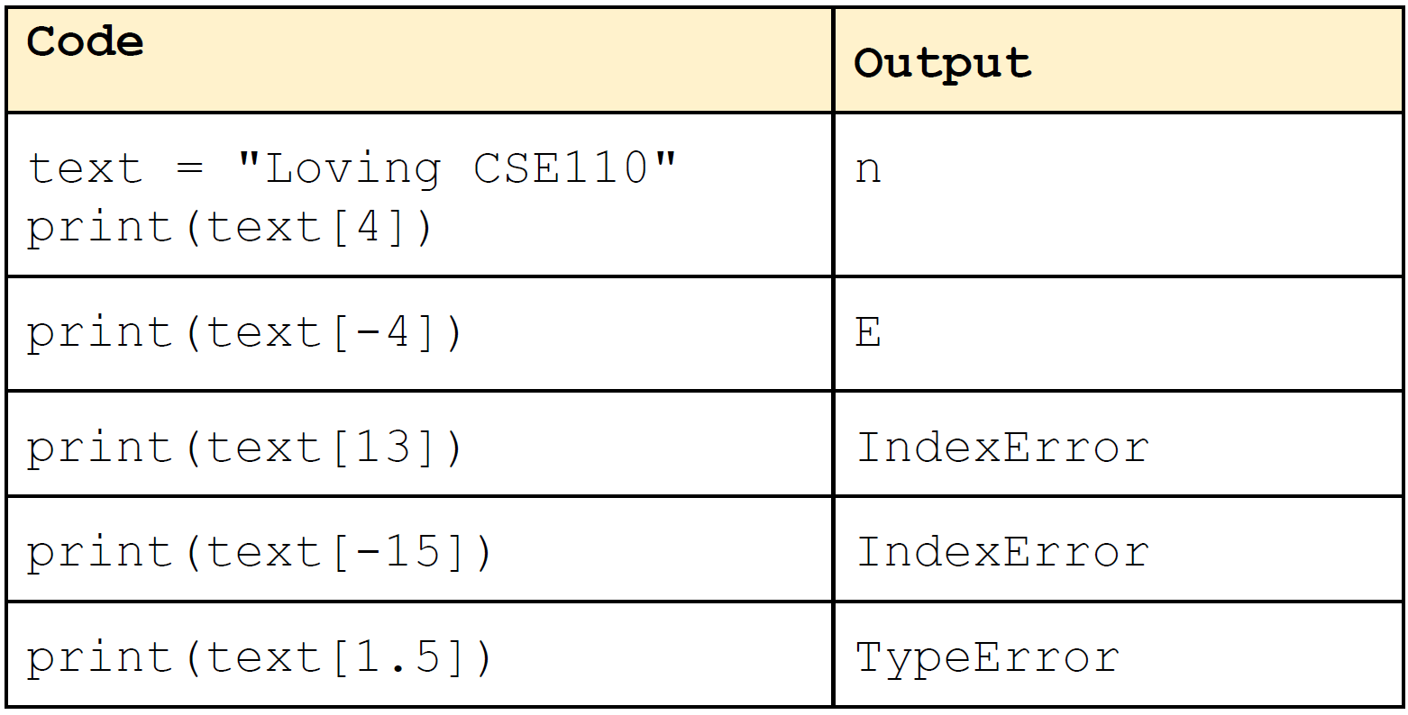
String Indexing

Slide 18
String Slicing
Slicing is used for getting a substring of a particular string.
In more general terms, it is used for accessing a particular range of characters.
Colon(:) is used as a slicing operator.
beginning: the index where slicing starts (inclusive). Default value is 0.
end: the index where slicing stops (Not inclusive). By default includes the rest of the string from the beginning.
step_size: Increment of the index value. Default value is 1.
string_name[ beginning : end : step_size ]

Slide 19
String Slicing
0
13
Positive Indexing
text = “I love Python!”
[2:6]
[7:13]
Code | Output
text[2:6] | love
text[0:6] | I love
text[:6] | I love
text[7:13] | Python!
text[7:] | Python!
text[2:10:2] | lv y

Slide 20
String Slicing
-14
-1
Negative Indexing
text = “I love Python!”
[-12:-8]
[-7:]
Code | Output
text[-12:-8] | love
text[:-8] | I love
text[-12:6] | love
text[-7:-1] | Python
text[-7:] | Python!
text[-12:-4:2] | lv y

Slide 21
String Operators
String Concatenation
x = “abc”
y = “def”
z = x + y
print(z)
a = “ ”
b = “ghi”
z = x + a + y + a + b
print(z)
Output:
abcdef
abc def ghi

Slide 22
String Repetition
Repetition: Creates a new string with the specified number of copies of the input string.
x = “abc”
y = x * 3
print(y)
Output:
abcabcabc

Slide 23
String Membership
x = “elephant”
a = “ph” in x
b = “ant” not in x
print(a)
print(b)

Slide 24
String Immutability
Python Strings are immutable, meaning they cannot be changed after they are created.
Output:
Error! We cannot change the string text after it has been created.
text = “Python”
text[0] = “C”

Slide 25
String Methods
len(string_name)
Returns the length of the string
x = “abcdef”
print(len(x))
Output:
6

Slide 26
String Methods
string_name.lower()
Returns a copy of the string with all upper case letters converted to lower case.
string_name remains unchanged afterwards.
text = “Hello, World!”
small = text.lower()
print(text)
print(small)
Output:
Hello, World!
hello, world!

Slide 27
String Methods
string_name.upper()
Returns a copy of the string with all lower case letters converted to upper case.
string_name remains unchanged afterwards.
text = “Hello, World!”
big = text.upper()
print(text)
print(big)
Output:
Hello, World!
HELLO, WORLD!

Slide 28
String Methods
string_name.startswith( another_string )
Returns True if string_name starts with another_string (or if another_string is a prefix of string_name).
Hello World!
Begins with:
(empty string)
H
He
Hel
Hell
… … …
Hello World
Hello World!
x = “Hello World!”
prefix = “hello”
if x.startswith(prefix):
print(“Prefix matched!”)
else:
print(“Prefix did not match!”)

Slide 29
String Methods
string_name.endswith( another_string )
Returns True if string_name ends with another_string (or if another_string is a suffix of string_name).
Hello World!
Ends with:
(empty string)
!
d!
ld!
rld!
… … …
ello World!
Hello World!
x = “Hello World!”
suffix = “Hello World!”
if x.startswith(suffix):
print(“Suffix matched!”)
else:
print(“Suffix did not match!”)

Slide 30
String Methods
string_name.count( sub_str )
Returns total occurrences of sub_str in string_name.
x = “abcabcab”
substr_count = x.count(“abc”)
print(substr_count)
Output:
2

Slide 31
String Methods
string_name.strip()
Removes all whitespaces (spaces, tabs, newlines etc.) from string_name at the beginning and in the end and returns the string.
string_name remains unchanged afterwards.
x = ‘ I love Python ’
y = x.strip()
print(x)
print(y)
Output:
‘ I love Python ’
‘I love Python’
Not at the beginning or in the end, so not removed.

Slide 32
String Methods
string_name.lstrip()
Removes all whitespaces (spaces, tabs, newlines etc.) from string_name at the beginning and in the end and returns the string.
string_name remains unchanged afterwards.
x = ‘ I love Python ’
y = x.lstrip()
print(x)
print(y)
Output:
‘I love Python ’
‘I love Python’

Slide 33
String Methods
string_name.rstrip()
Removes all whitespaces (spaces, tabs, newlines etc.) from string_name at the beginning and in the end and returns the string.
string_name remains unchanged afterwards.
x = ‘ I love Python ‘
y = x.rstrip()
print(x)
print(y)
Output:
‘ I love Python’
‘I love Python’

Slide 34
String Methods
string_name.replace( old_str, new_str)
Replace every instance of old_str with new_str in string_name and returns the new string.
string_name remains unchanged afterwards.
x = “Hello World!”
y = x.replace(“World”, “Python”)
print(x)
print(y)
Output:
Hello World!
Hello Python!

Slide 35
String Methods
string_name.find( sub_str )
Returns the index of the first occurrence of sub_str in string_name.
x = “abcabcab”
substr_index = x.find(“bca”)
print(substr_index )
Output:
1

